Slide 1
Modeling Cultural Resource distribution Using Pearson’s Chi-squared goodness-of-fit tests and standard residuals for categorical variables

Slide 2
Cultural Resource Modeling
Methodology
Example
Considerations
Sources of Bias
Best Practices
Troubleshooting

Slide 3
General approach:
Model site distribution across a study area using categorical independent variables and known site locations within existing survey boundaries.
Categorical inputs
Known sites within existing surveys

Slide 4
Methodology:
For each categorical independent (predictor) variable:
Use Pearson’s Chi-Squared Goodness-of-Fit Test to assess if the observed distribution of sites differs significantly from the expected distribution under the null hypothesis that there is no relationship between site distribution and the input variable.
If the difference between the observed and expected distributions is significant, reweight the input variable feature classes according to the standard residuals for each class.
Intersect the significant inputs and average the standard residuals.

Slide 5
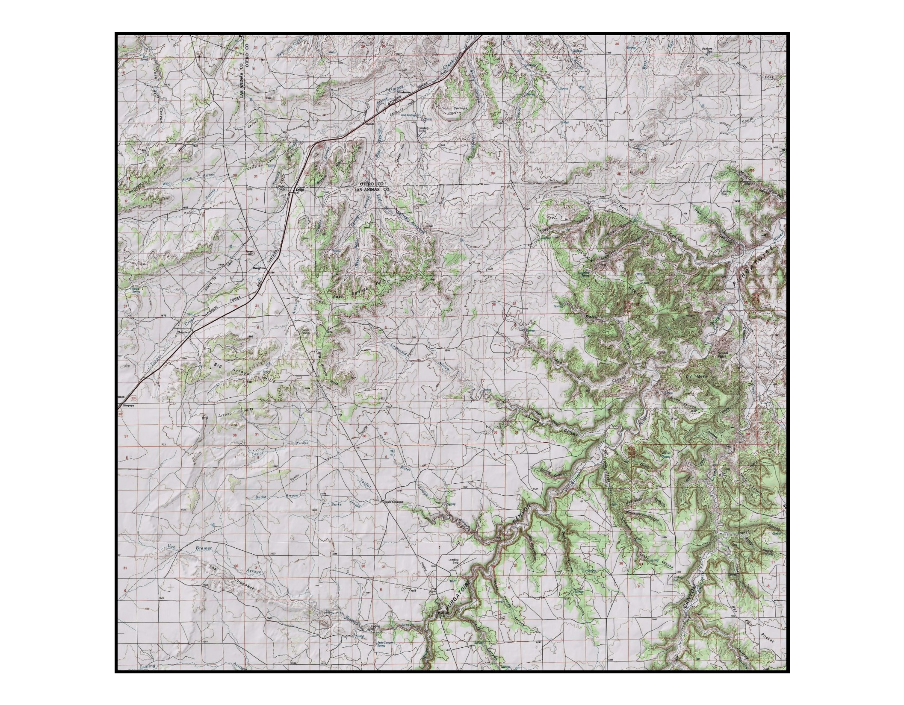

Slide 6
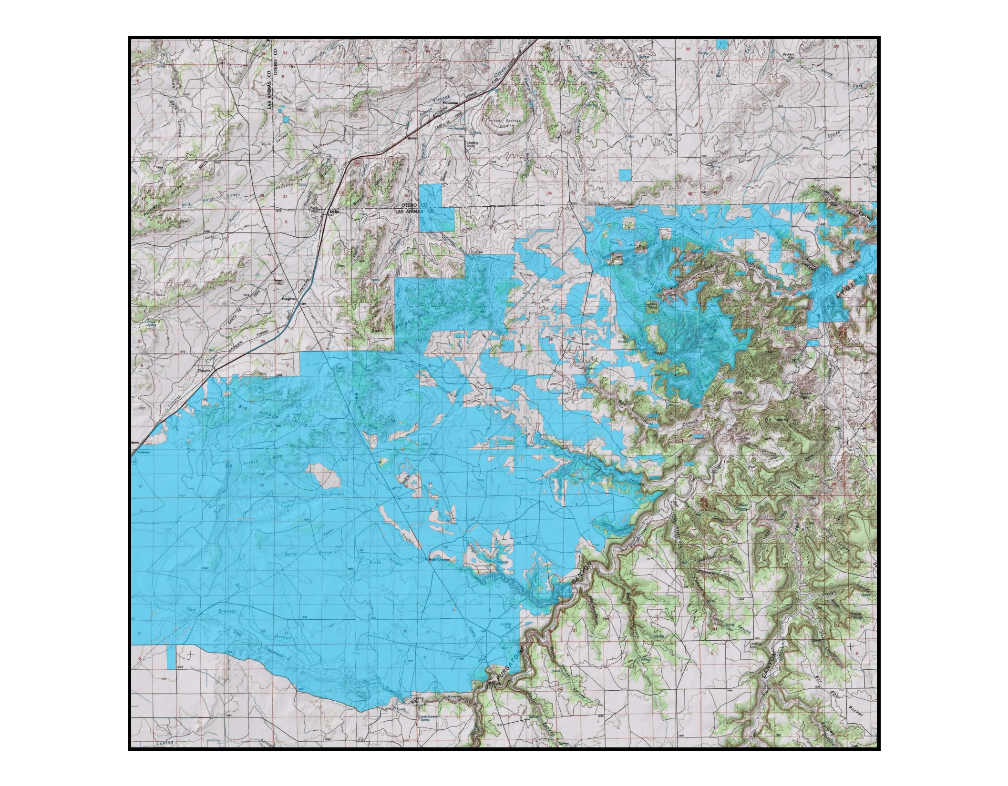

Slide 7
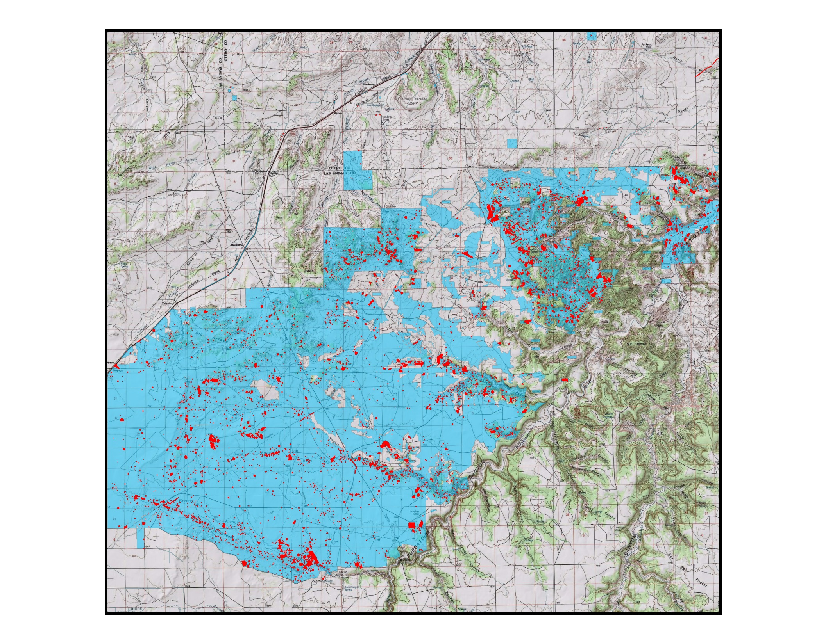

Slide 8
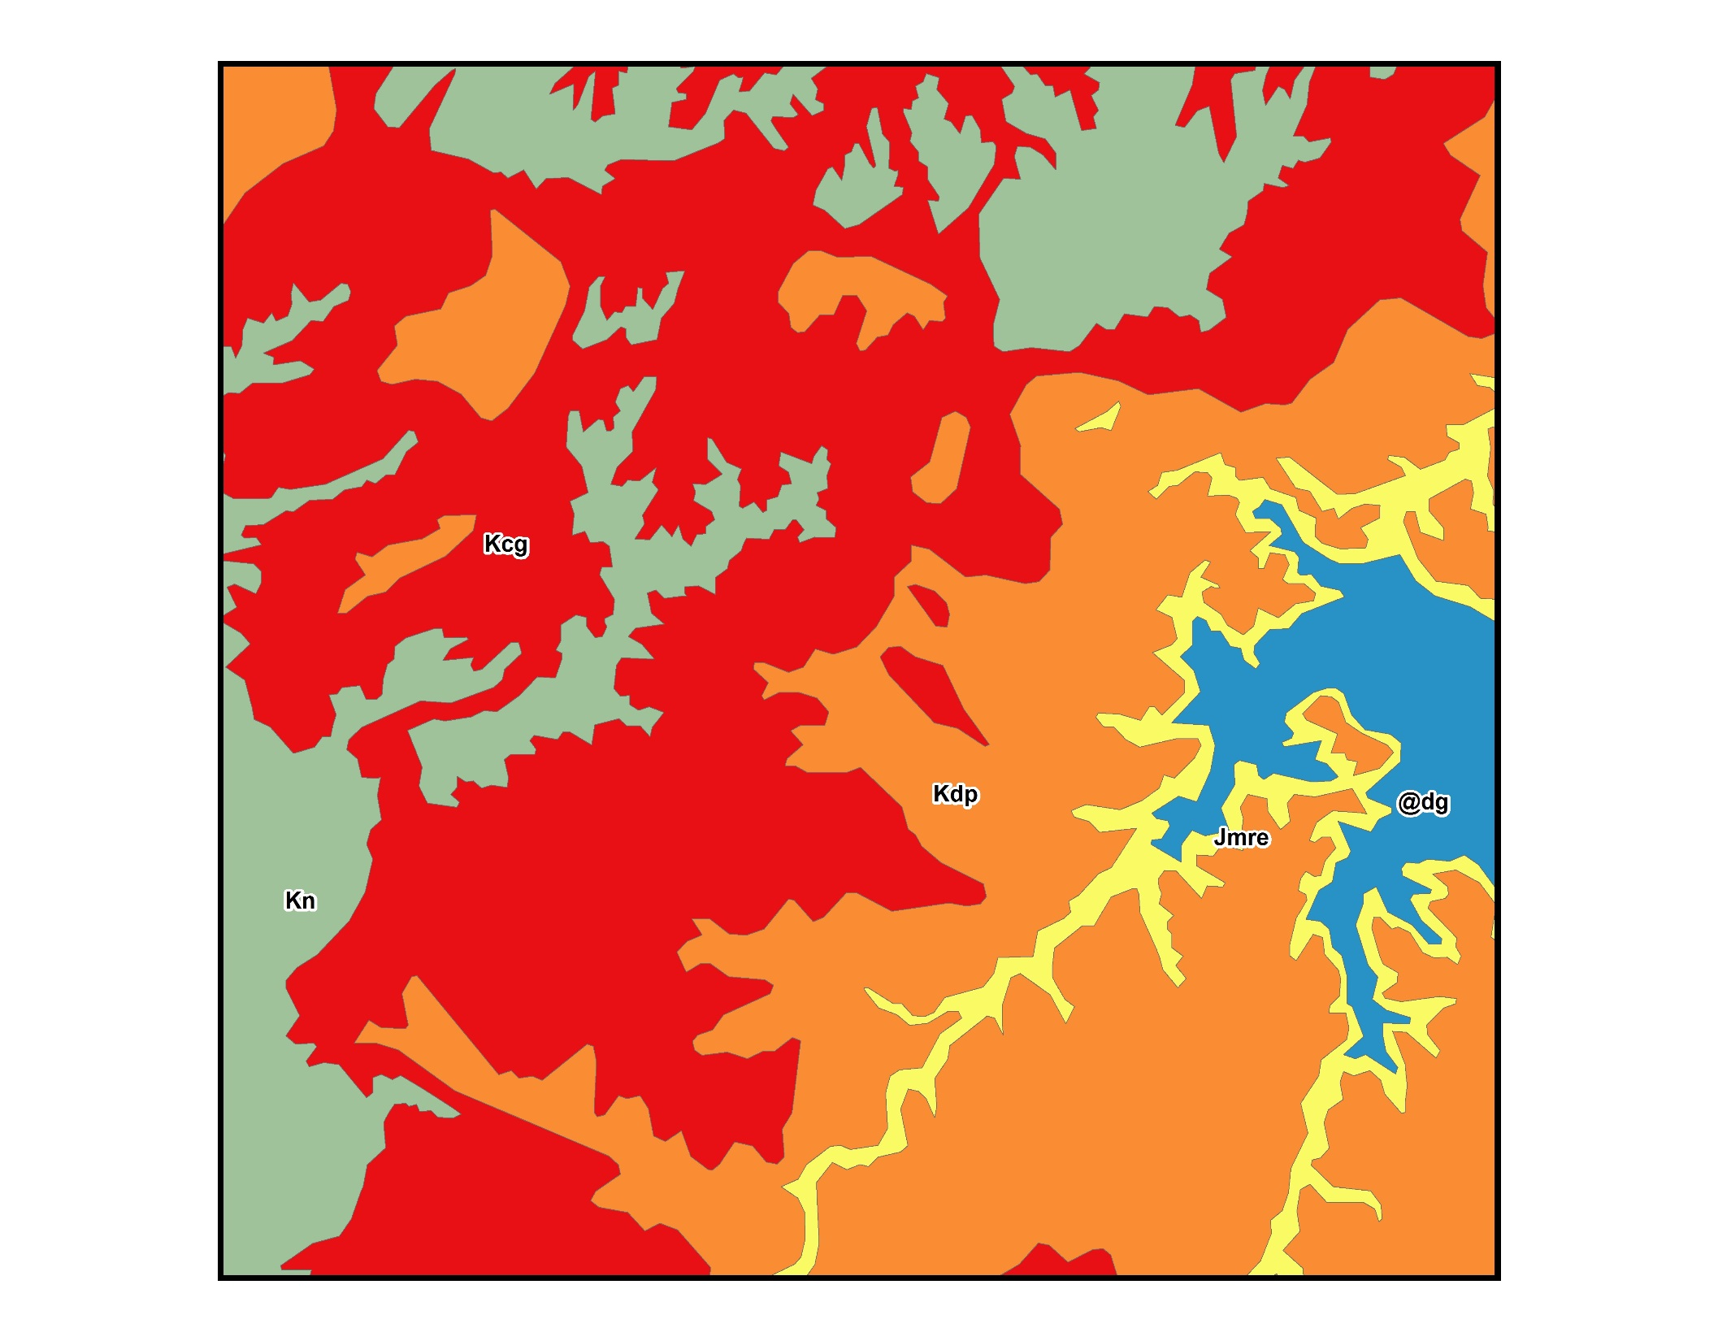

Slide 9
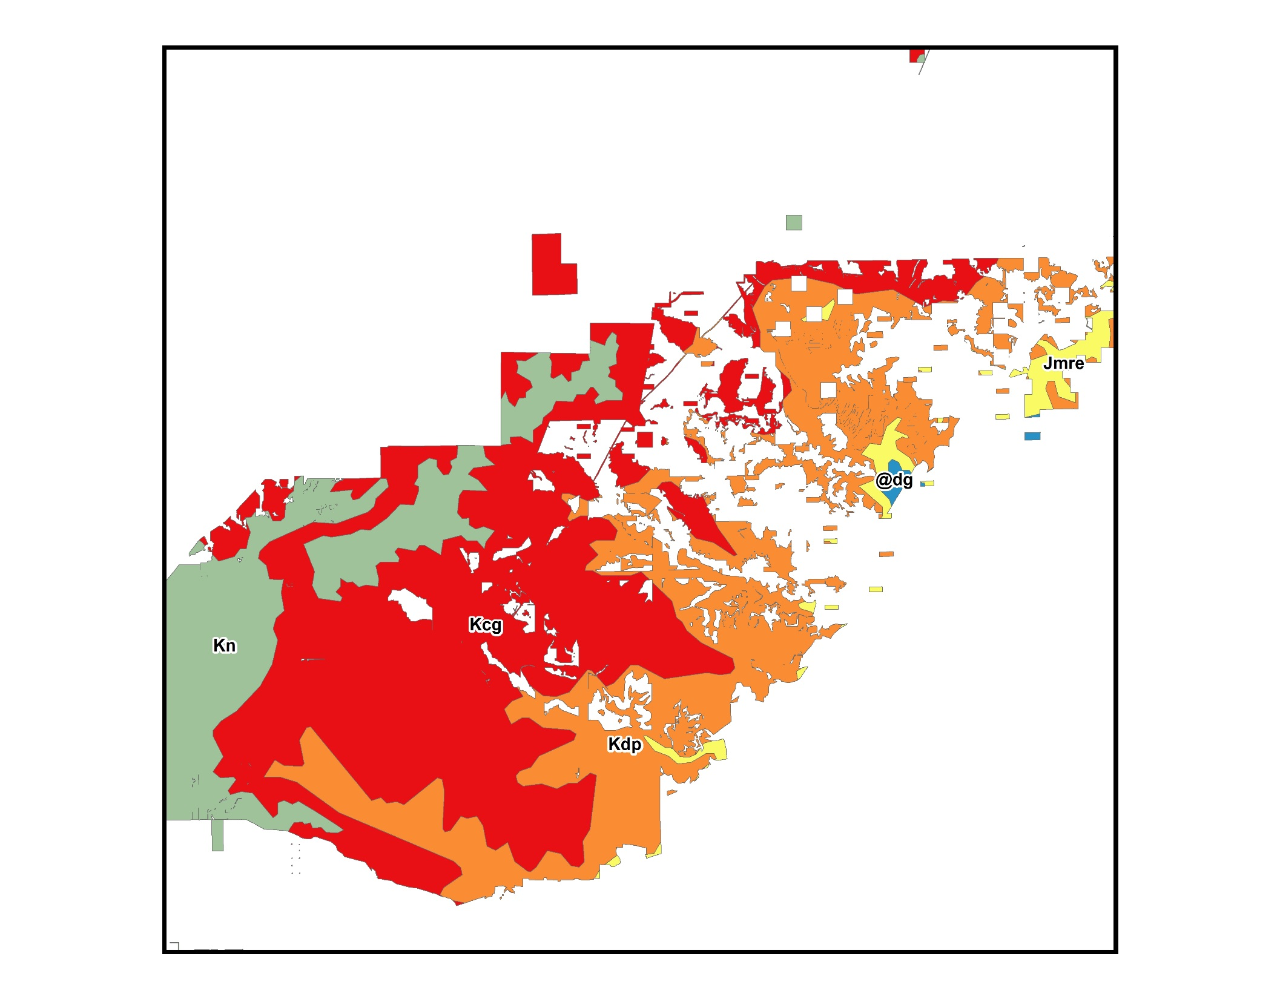

Slide 10
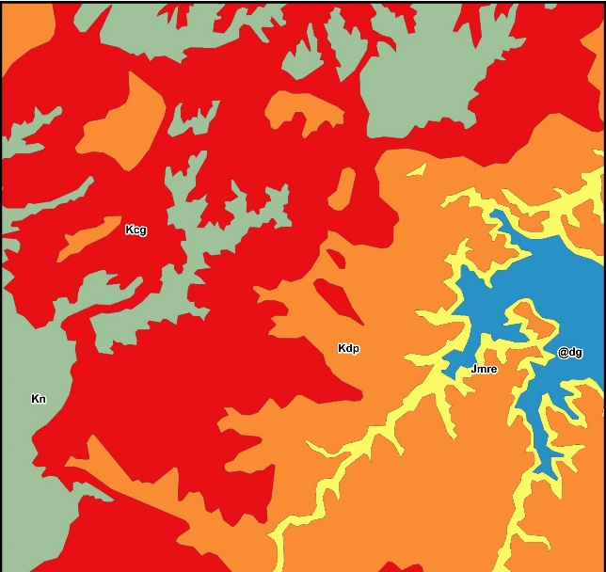
input: geology
Total Analysis Acres | 589,769
Total Surveyed Acres | 188,788
Total Sites | 4889
 | Class | Acres | Proportion | Expected | Observed
 | Dg | 580 | 0.003 | 15 | 45
 | Jmre | 5070 | 0.027 | 131 | 226
 | Kn | 31902 | 0.169 | 826 | 658
 | Kdp | 56300 | 0.298 | 1458 | 2325
 | Kcg | 94939 | 0.503 | 2459 | 1635
Total |  | 188,788 | 1 | 4889 | 4889

Slide 11
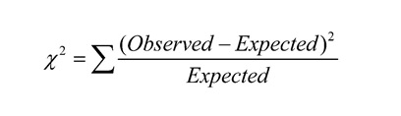
Chi-square test statistic
Null Hypothesis – H0:
No relationship
Test Hypothesis – H1:
Relationship*
 | Class | Exp. | Obs. | Obs. – Exp. | Diff.^2 | Diff^2 / Exp.
 | Dg | 15 | 45 | 30 | 900 | 60
 | Jmre | 131 | 226 | 95 | 9025 | 68.89
 | Kn | 826 | 658 | -168 | 28224 | 34.17
 | Kdp | 1458 | 2325 | 867 | 751689 | 515.56
 | Kcg | 2459 | 1635 | -824 | 678976 | 276.12
Total |  | 4889 | 4889 | 0 |  | 954.74
df = n(classes) – 1 alpha=0.05

Slide 12
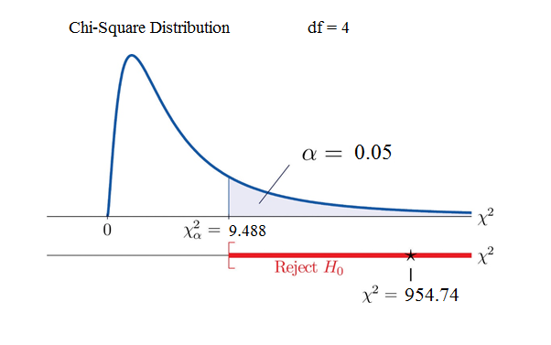

Slide 13

Standard residuals
Measures class contribution to overall Chi-Square score.
Values in excess of +/- 2 are considered significant.
(Observed – Expected)
Std. Res =
Sqrt(Expected)
 | Class | Exp. | Obs. | Obs – Exp | Sqrt(Exp.) | Std. Residuals
 | Dg | 15 | 45 | 30 | 3.87 | 7.75
 | Jmre | 131 | 226 | 95 | 11.45 | 8.29
 | Kn | 826 | 658 | -168 | 28.74 | -5.85
 | Kdp | 1458 | 2325 | 867 | 38.18 | 22.71
 | Kcg | 2459 | 1635 | -824 | 49.59 | -16.62

Slide 14
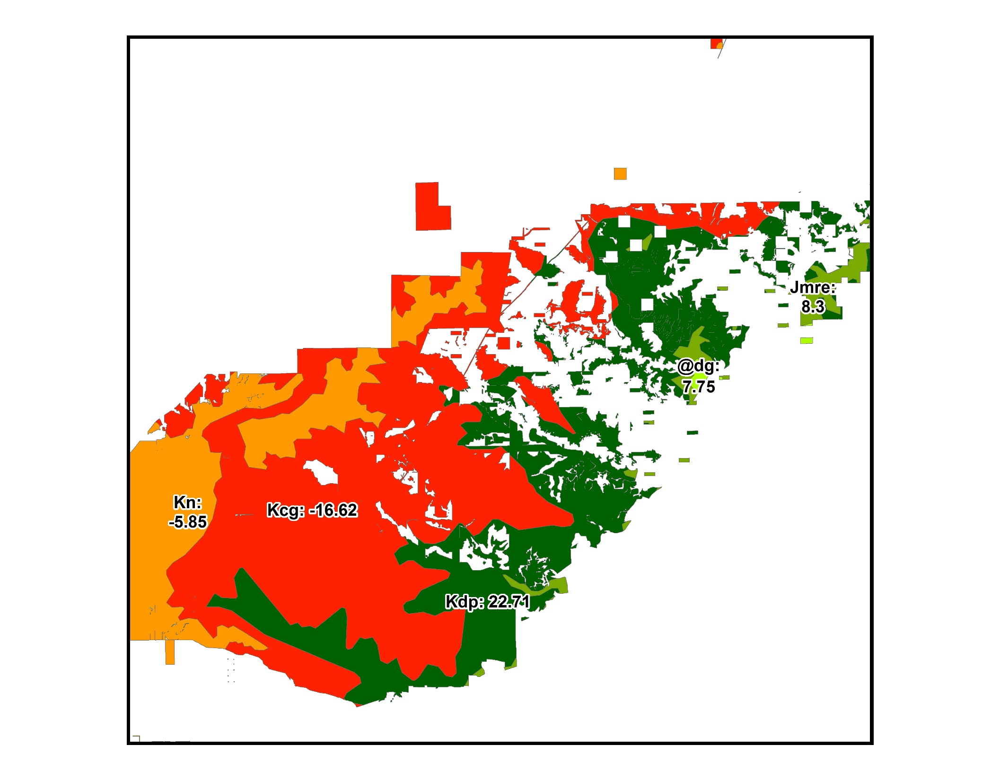

Slide 15
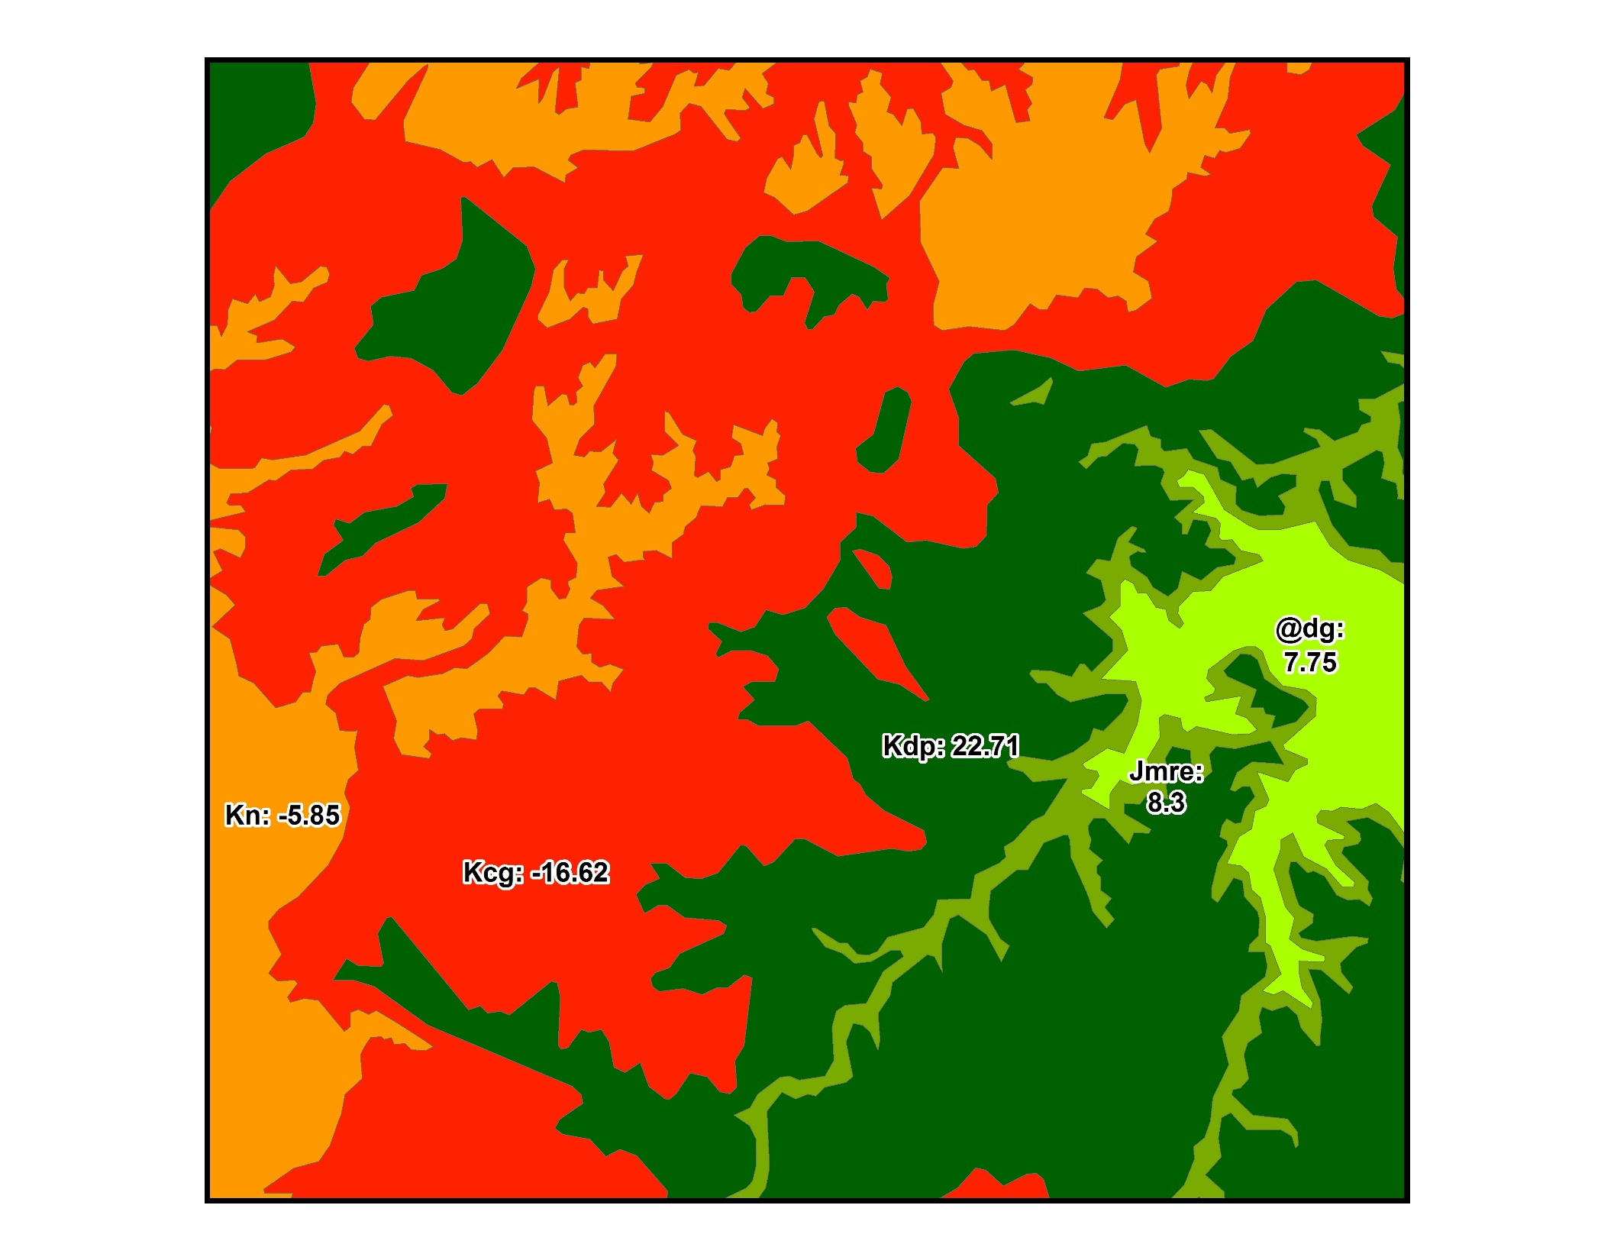

Slide 16
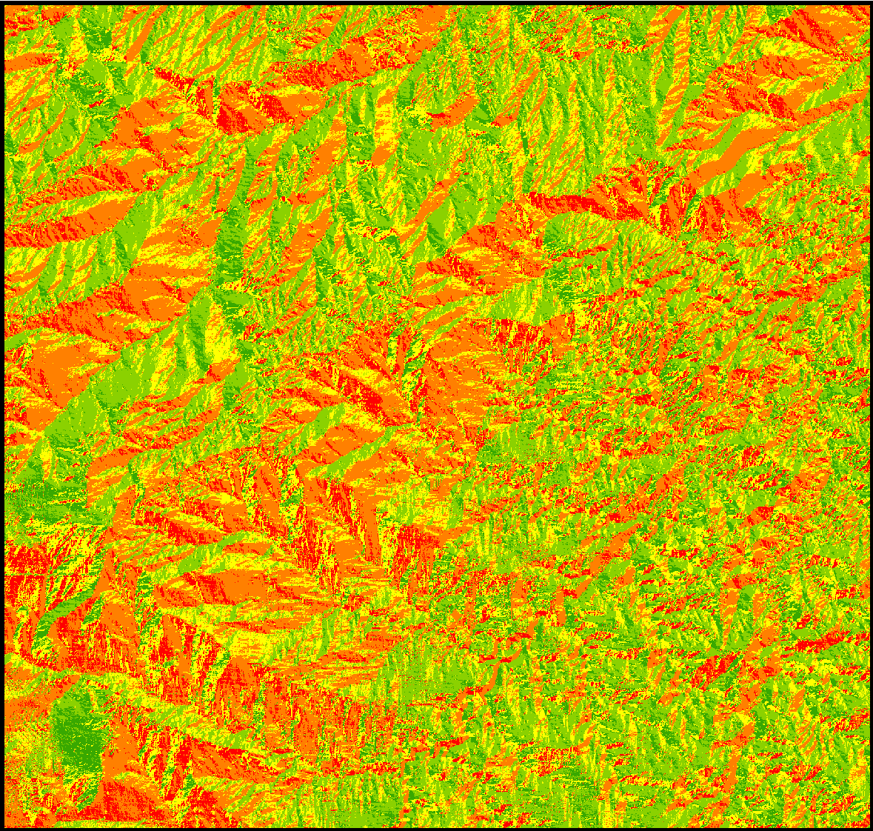
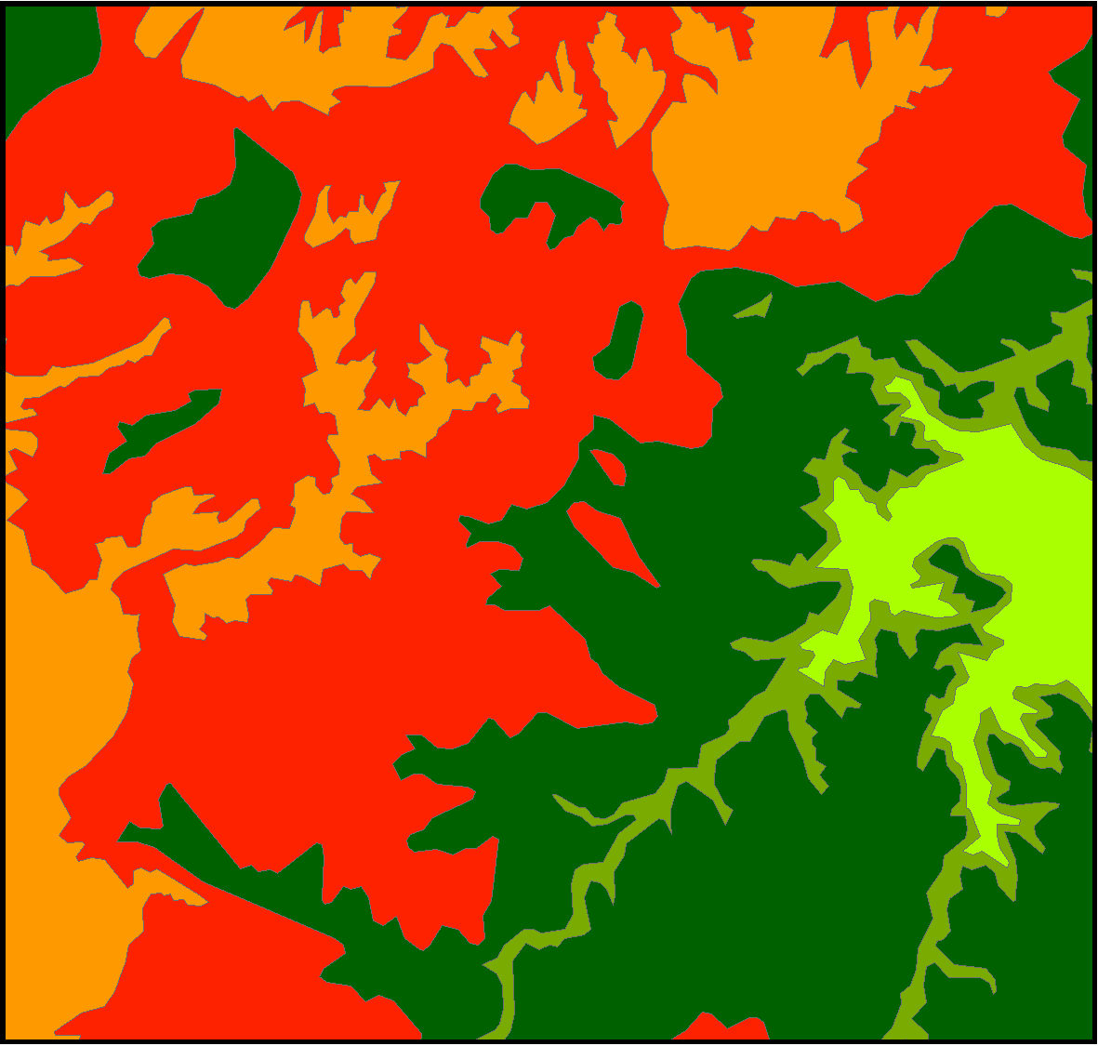
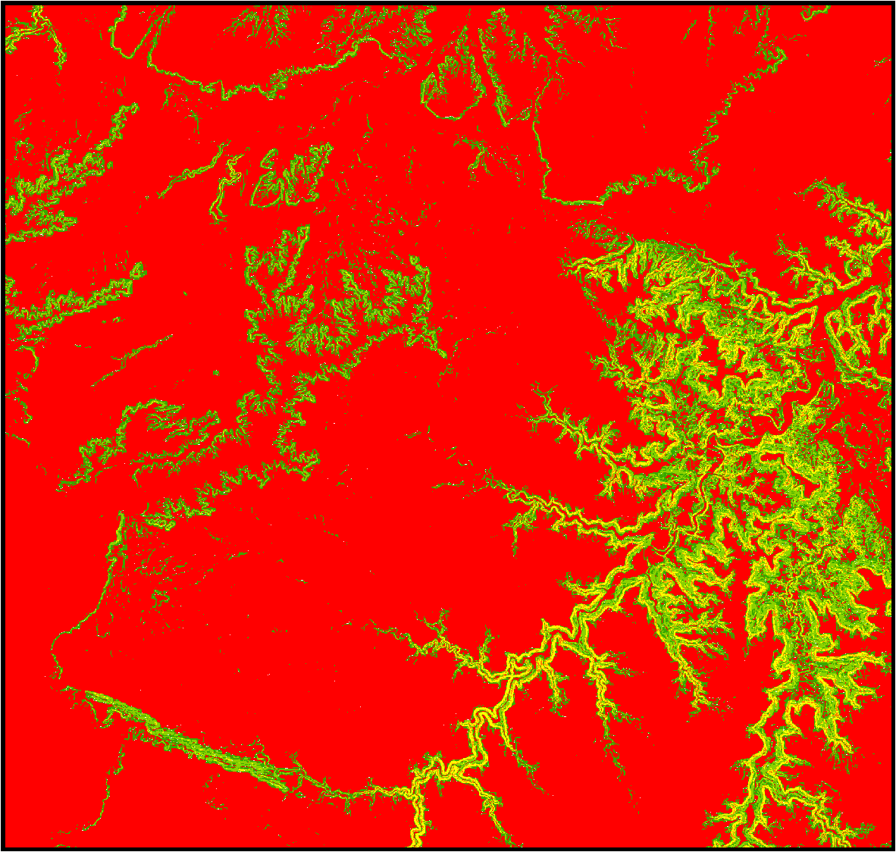
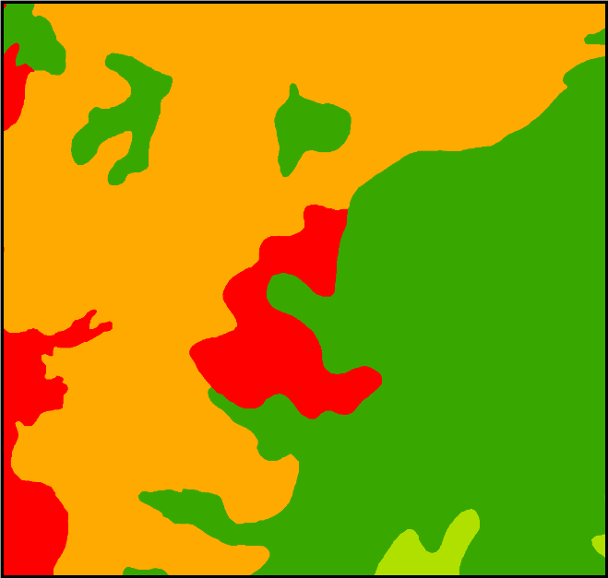
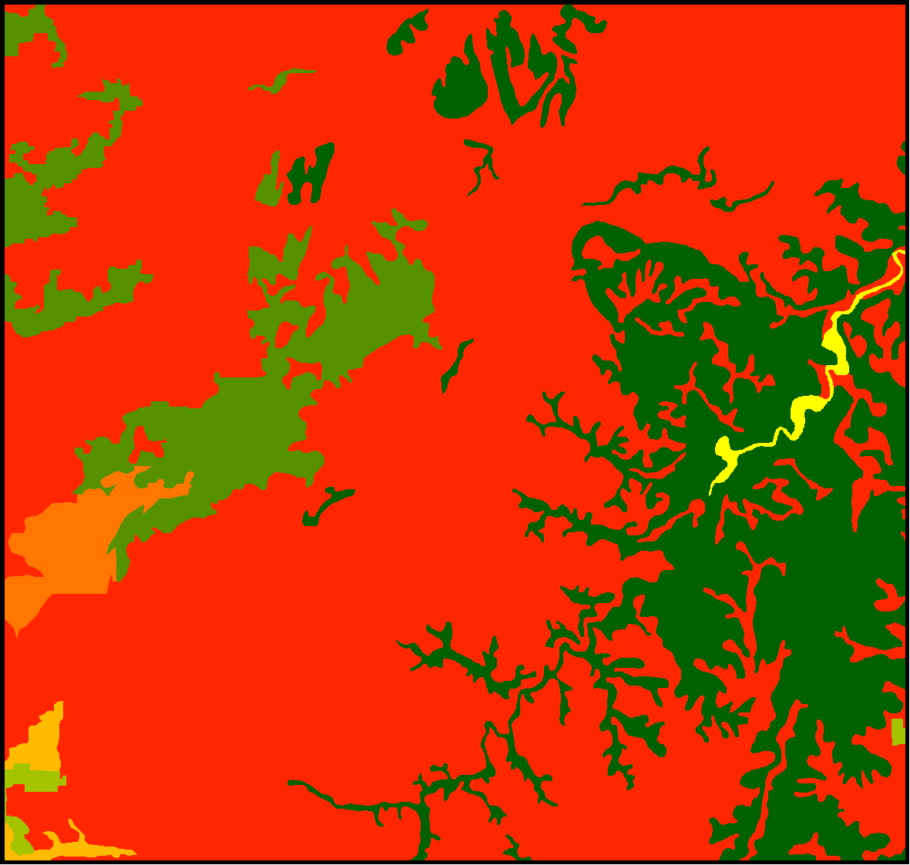
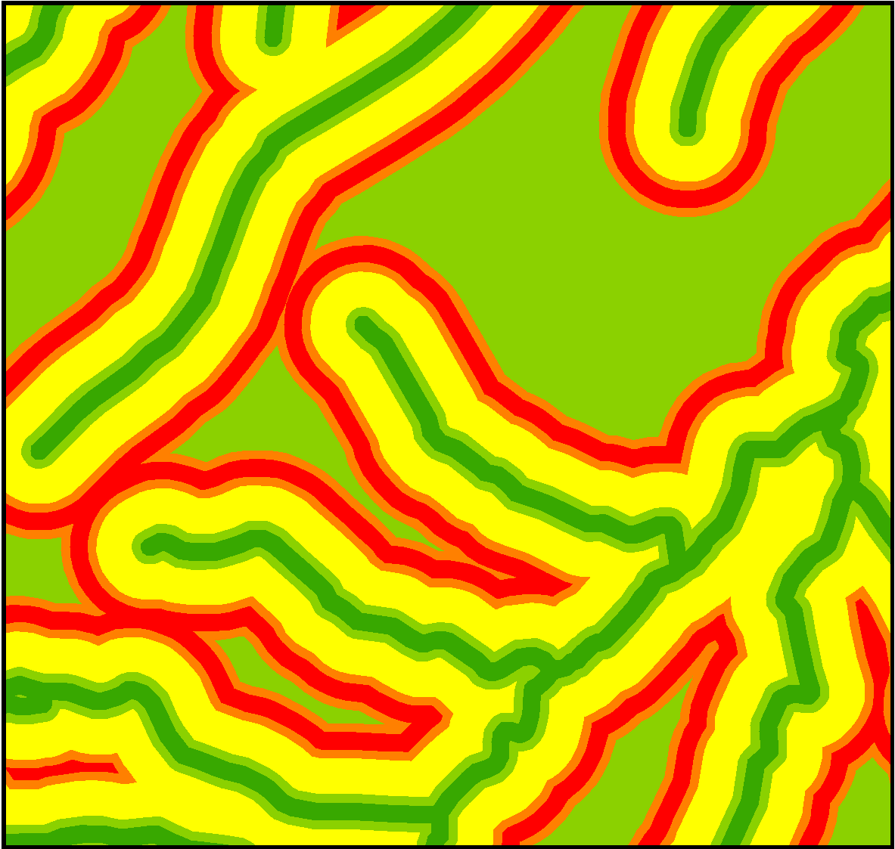

Slide 17
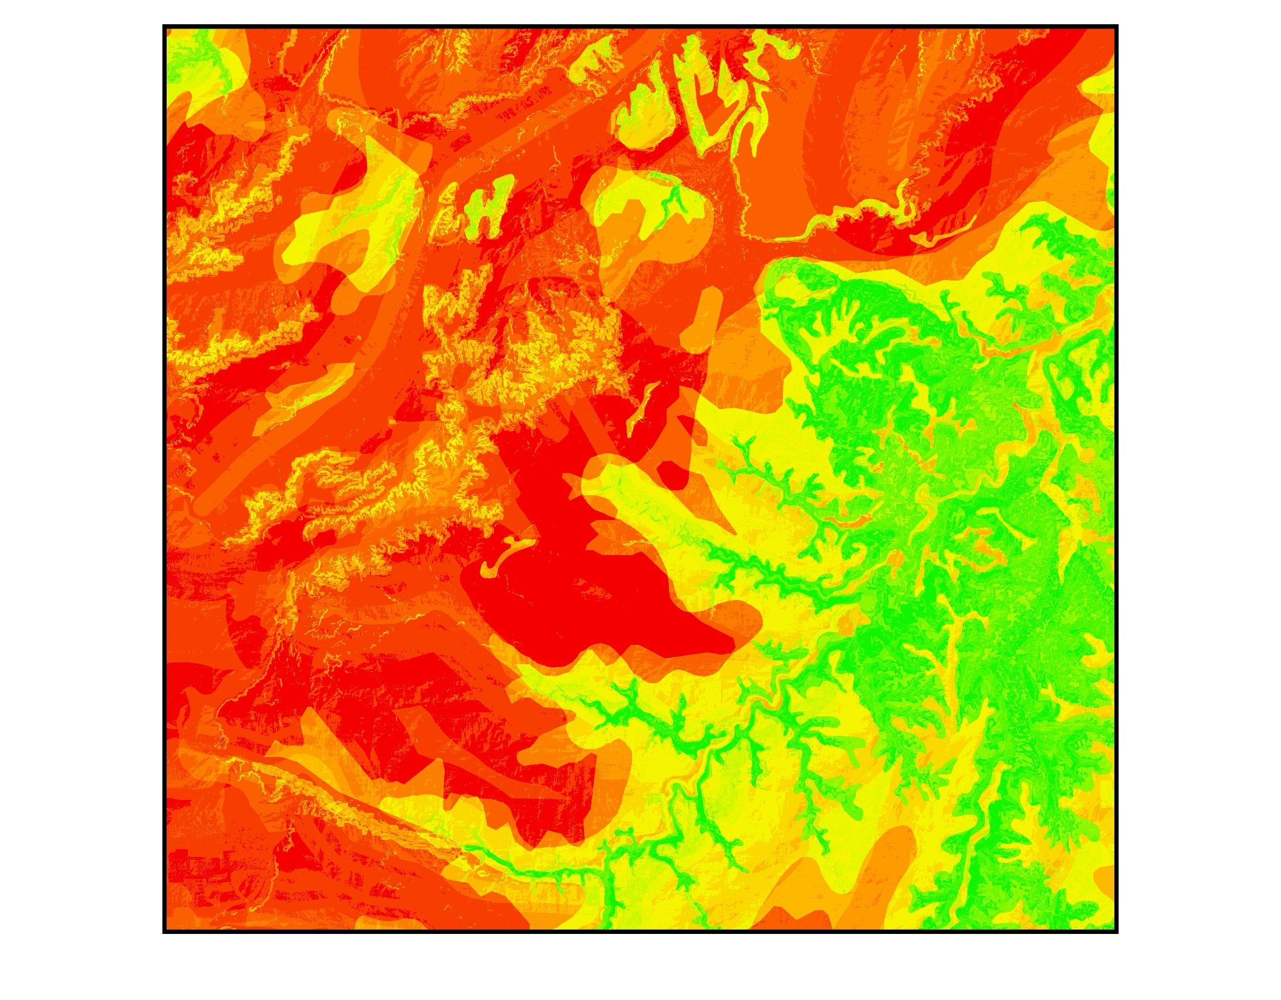

Slide 18
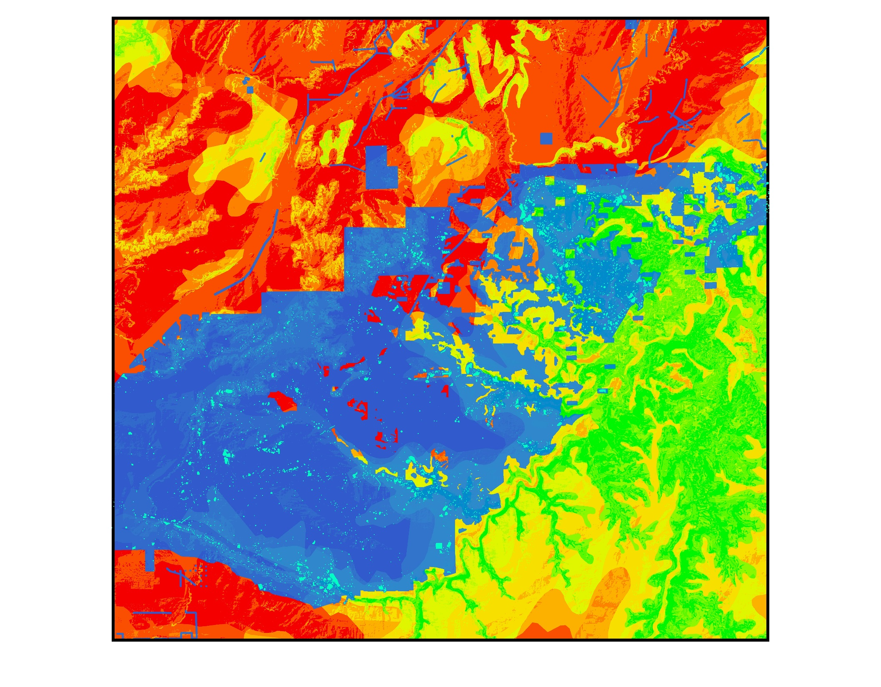

Slide 19
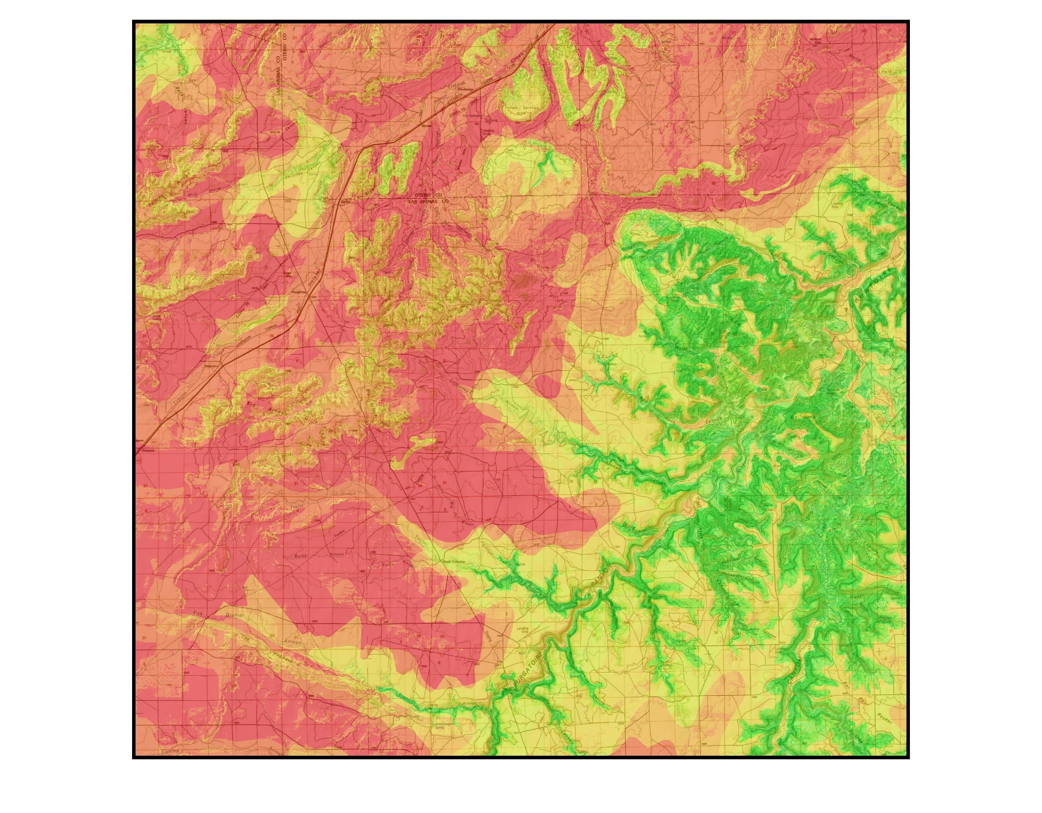

Slide 20
Modeling assumptions:
Simple random sample:
All sites have an equal probability of being ‘sampled’ – in our case, being identified as a result of survey. Surveys are obviously not random, but this effectively boils down to two important considerations:
Are the recorded sites of interest representative of all sites of interest within the analysis area?
We generally assume this to be the case, else why model in the first place..
Is the existing survey ‘sample’ coverage correlated with one or more of the input variables?
E.g. Did you specifically survey a ton of Piñon-Juniper as part of a fuels project and now want to include vegetation in you model?
Bad idea – your sample is correlated with veg type..
All sites are equal:
Unweighted - size and intra-site dynamics are not considered.

Slide 21
Modeling assumptions:
Sufficient sample size:
Generally a minimum of 30 observations, though this is really low for cultural data! The tool will not run with less than 30 sites, but you should shoot for 100+. More is always better, so long as you aren’t just introducing more noise.
Minimum of 5 expected/observed values per cell:
Variable classes with fewer than 5 expected or observed values are problematic and the results are misleading; collapse the category or get more sites.

Slide 22
Tool Example

Slide 23
Modeling considerations:
Sample size and quality is everything!
Garbage in, garbage out.
Be critical of your site, survey, and input data.
The more specific the area and cultural phenomenon, the more specific the results.
Does it make sense to model disparate geographical areas and different cultures at the same time?
Cultural data is really noisy to begin with (taphonomy, survey and recording bias, weird human behavior), don’t make it worse by conflating unrelated time periods, groups, areas, etc..
You can model at the large scale, but be aware that the model is trying to capture a lot of intrinsic variation, and you may get more insight from modeling a smaller area, narrower site-type, etc..

Slide 24
Interpreting the results:
Use the mean value for all input standard residuals.
Helps correct for correlation in inputs and allows for comparison between models with different numbers of inputs.
Correlation is not causation.
The test methodology only identifies where sites are over/under-represented with regard to known distribution/density.
The tool does not tell you why a relationship exists!
Generally, a relationship between variables takes the form:
Environmental variable influences site location (possible)
Site location influences environmental variable (less likely)
Site location and environmental variable are unrelated (chi2 test)
Both are under the effect of some other variable (possible)
E.g. Are sites within a specific veg community more visible due to fire?

Slide 25
Sources of bias: (sneaky things that screw up your model)
Correlated inputs:
If two or more of your inputs are correlated, including them in the same analysis is measuring the same thing twice and biasing your results in favor of the correlated data.
E.g. Distance to stream and distance to confluence
This is generally not so easy to spot, which is why we use the mean of the standard residuals.
Noisy sample data:
Trying to model a specific pattern/phenomenon when your data is full of many patterns/phenomena will not generally yield good results; sort out your data.
Data quality – accuracy of geometry and attributes:
So many ways to go wrong!

Slide 26
Best practices:
Give your variables meaningful names.
Experiment – this is not a model, it is a model factory.
Build some models
Critically evaluate model:
Do the results accord with your intuition?
Do the standard residuals make sense (direction)?
Validate your results!

Slide 27
Troubleshooting:
The tool handled an expected error:
Insufficient site sample (<30)
Insufficient survey coverage (< 10%)
Insufficient input variable coverage (must cover whole analysis area)
Overlapping polygons:
Your input self-overlaps. This screws up the acre calculations.
Single feature:
Dissolving on the analysis field yields a single row.
Null class names:
One of the inputs has a null or empty value for the analysis field.
Observed/Expected values of < 5:
You have one or more very small classes in your input and/or too few sites.

Slide 28
Troubleshooting:
The tool encountered an unexpected error:
Make sure logging is enabled.
Recreate error with logging If necessary.
Geoprocessing -> Results -> double-click tool execution record
Review the log for obvious issues:
Wrong path names, etc..
Email the error log to Michael. Wait for me to fix it..

